Slide 1

POWER CONSUMPTION ANALYSIS FOR HOUSEHOLDS
PRESENTED BY:
TEAM NO: CSE-014
18UK1A0537 -NAGUNURI VIKAS
18UK1A0521- JANGA SPANDANA REDDY
18UK1A0568 - BATTULA SAI SAMYUKTHA
18UK1A0564 - CHELUMALLA SHRAVYA

Slide 2
OUTLINE
INTRODUCTION
OBJECTIVE
DATA
MACHINE LEARNING APPROACHES
VISUALIZATION OF GRAPHS
SOFTWARE REQUIREMENTS
CONCLUSION

Slide 3
INTRODUCTION
Electricity sector in India. India is the world's third largest producer and third largest consumer of electricity. The gross electricity consumption in 2018-19 was 1,181 kWh per capita. Energy use can be viewed as a function of total GDP, structure of the economy and technology. The increase in household energy consumption is more significant than that in the industrial sector. To achieve reduction in electricity consumption, it is vital to have current information about household electricity use. This Guided Project mainly focuses on applying a machine-learning algorithm to calculate the power consumed by all appliances. This will help you track the power consumed on regular intervals for all kinds of appliances which use heavy loads such as Air Conditioners, Oven or a washing machine etc.

Slide 4
OBJECTIVE
You’ll be able to understand the problem to classify if it is a regression or a classification kind of problem.
You will be able to know how to pre-process/clean the data using different data pre-processing techniques.
Applying different algorithms according to the dataset
You will be able to know how to find the accuracy of the model.
You will be able to build web applications using the Flask framework.

Slide 5
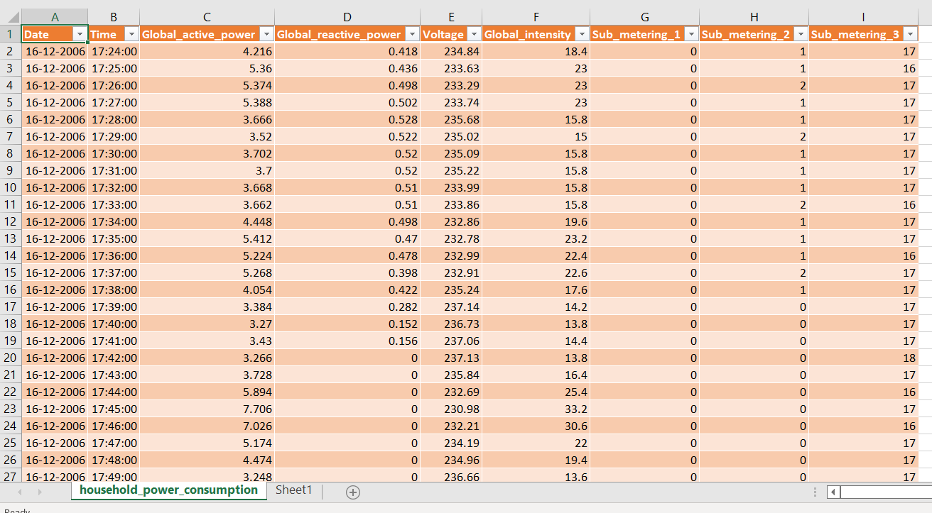
DATA
3D printer material dataset consists of:
1048576rows with 10columns
Date
Time
Global_active_power
Global_reactive_power
Voltage
Global_intensity
Sub_metering_1
Sub_metering_2
Sub_metering_3
Data source: Internet

Slide 6
DATA VISUALISATION
Data visualization is where a given dataset is presented in a graphical format. It helps the detection of patterns, trends and correlations that might go undetected in text-based data. Understanding your data and the relationship present within it is just as important as any algorithm used to train your machine learning model. Machine learning models will perform poorly on data that wasn’t visualized and understood properly.
To visualize the dataset we need libraries called Matplotlib and Seaborn. The Matplotlib library is a Python 2D plotting library that allows you to generate plots, scatter plots, histograms, bar charts etc.

Slide 7
MODEL BUILDING
There are several Machine learning algorithms to be used depending on the data you are going to process such as images, sound, text, and numerical values. The algorithms that you can choose according to the objective that you might have it may be Classification algorithms are Regression algorithms.
Example:
1.Linear Regression
2.Logistic Regression
3. Random Forest Regression / Classification.
4. Decision Tree Regression / Classification.
You will need to train the datasets to run smoothly and see an incremental improvement in the prediction rate.
On our Dataset , we have applied Linear Regression / Classification.
to predict the Accuracy.

Slide 8
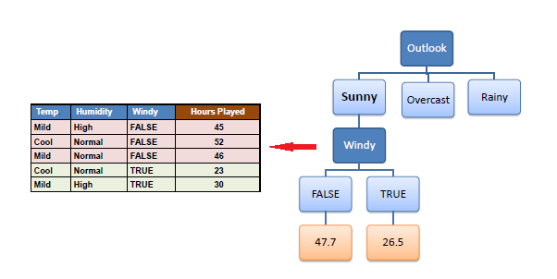
MACHINE LEARNING ALGORITHMS
Decision Tree Regression :
Decision Trees are a type of Supervised Machine Learning (that is you explain what the input is and what the corresponding output is in the training data) where the data is continuously split according to a certain parameter. An example of a decision tree can be explained using above binary tree.
Out of all the algorithms Decision Tree Regression got the highest accuracy .
So, We build a model with Decision Tree Regression.

Slide 9
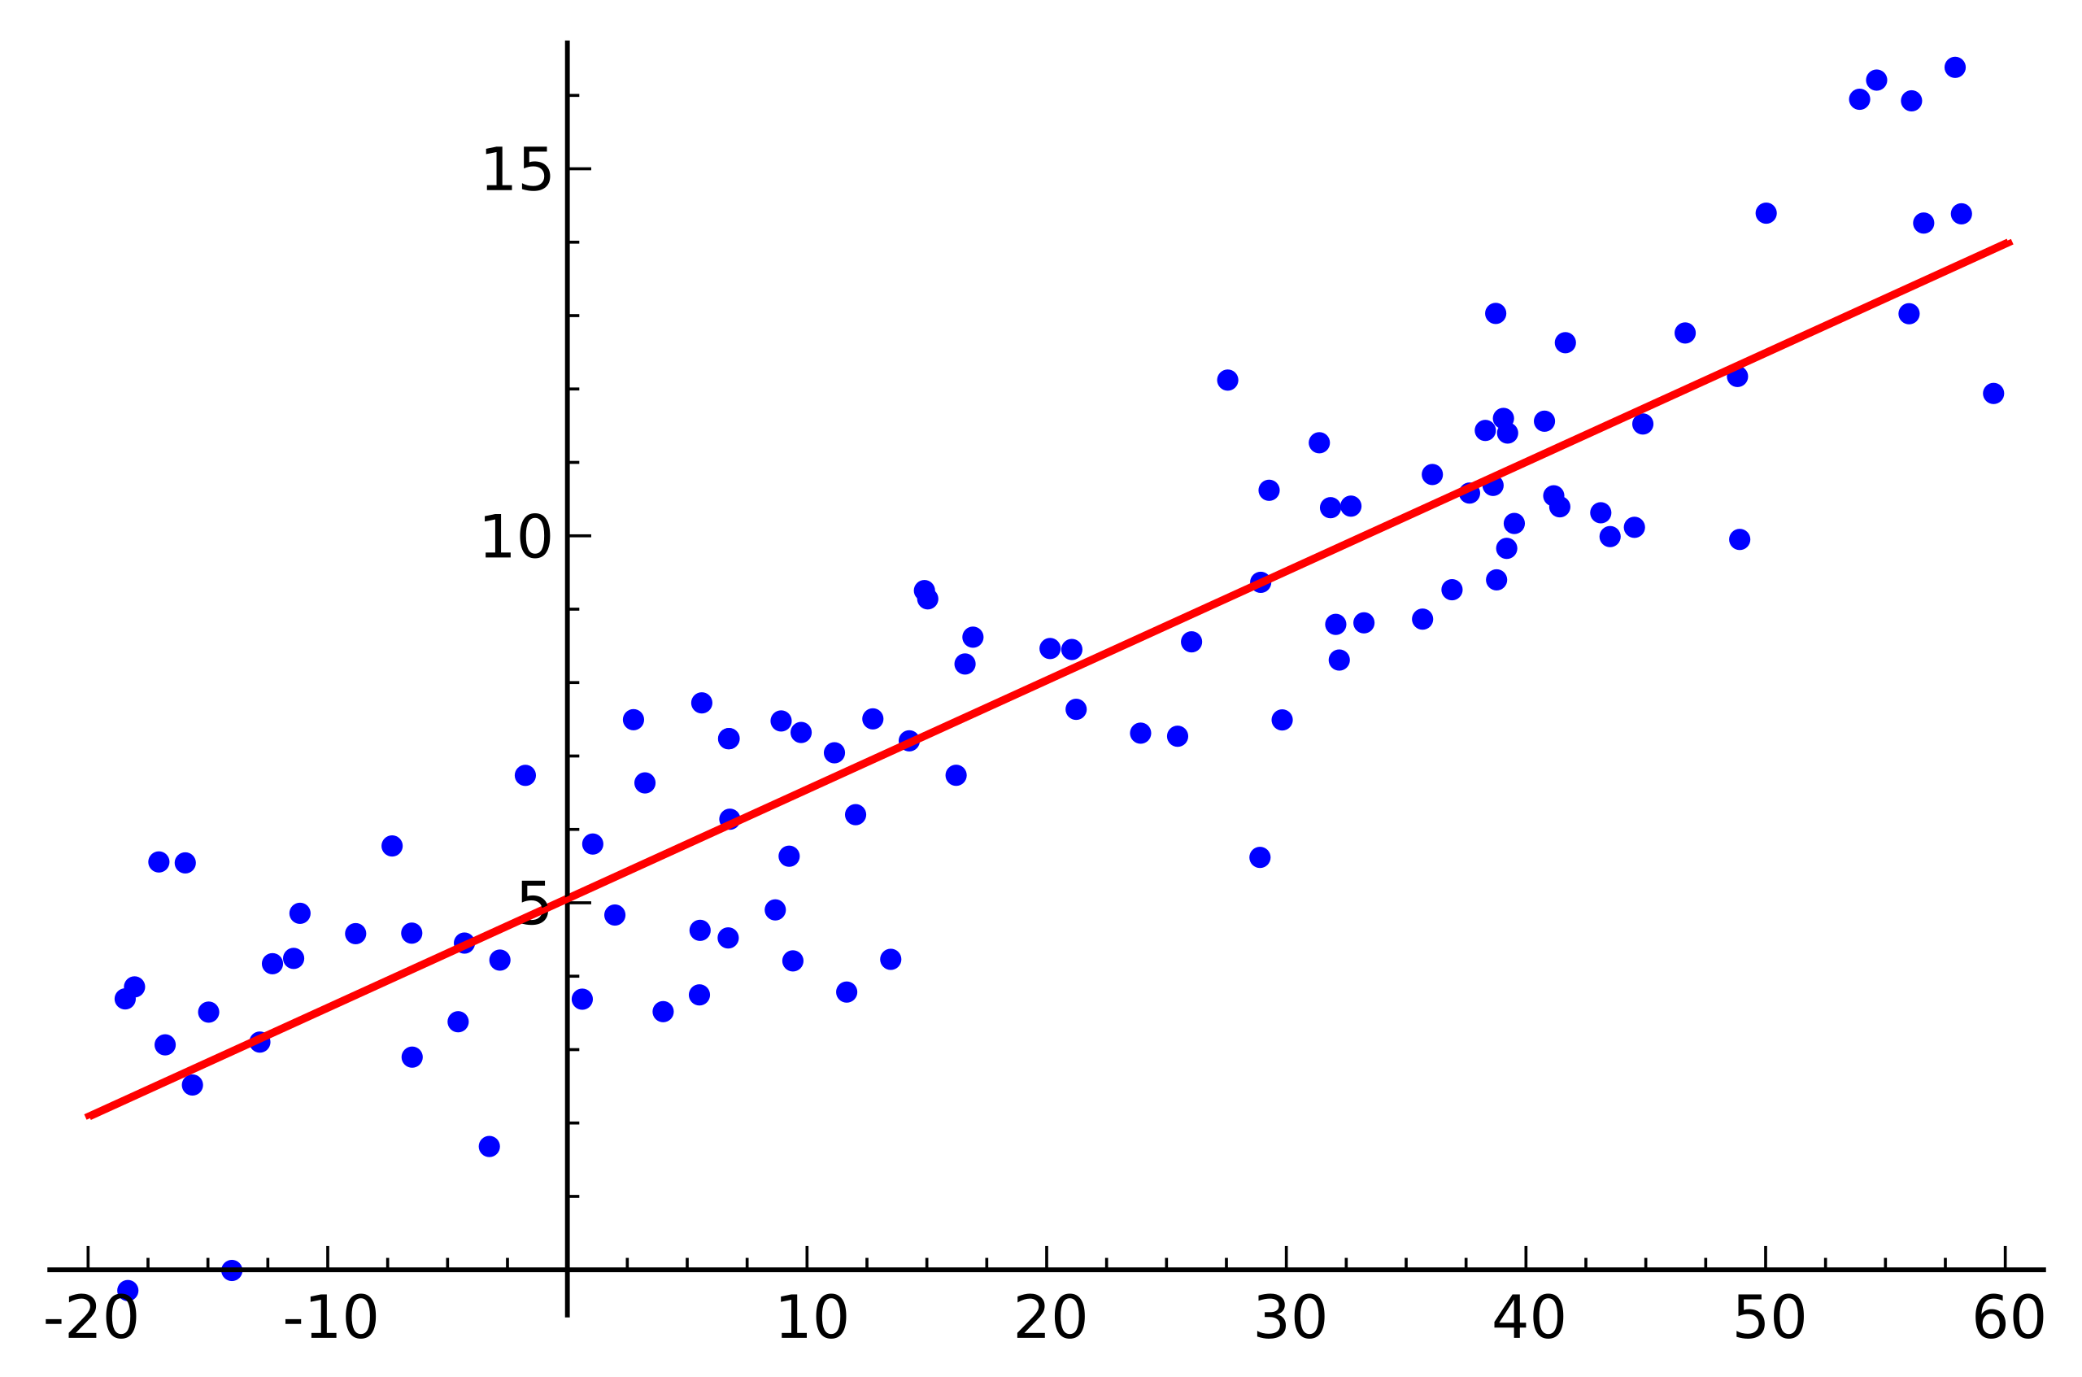
MACHINE LEARNING ALGORITHMS
Linear Regression :
In statistics, linear regression is a linear approach for modelling the relationship between a scalar response and one or more explanatory variables. The case of one explanatory variable is called simple linear regression.
Out of all the algorithms Decision Tree Regression got the highest accuracy
So, We build a model with Decision Tree Regression.

Slide 10
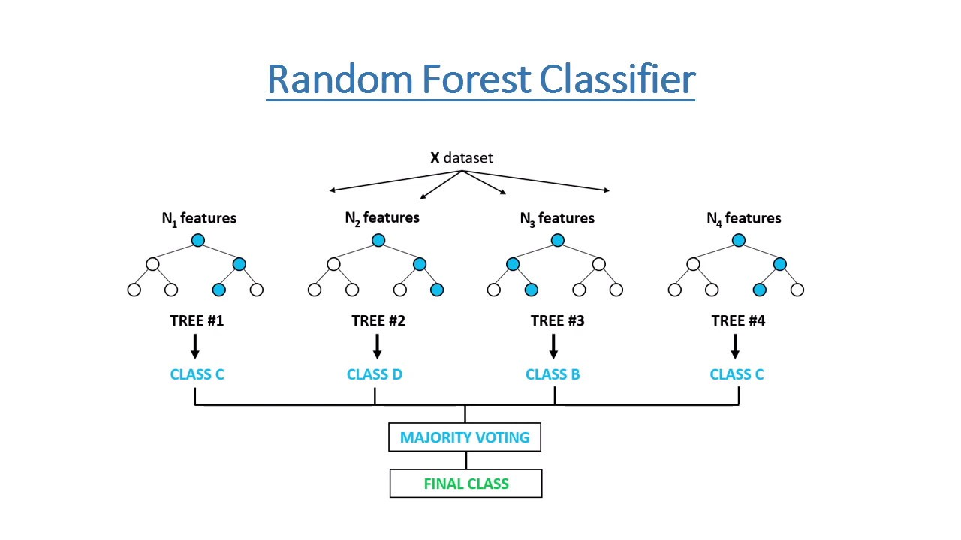
Random Forest :
A random forest is a machine learning technique that’s used to solve regression and classification problems. It utilizes ensemble learning, which is a technique that combines many classifiers to provide solutions to complex problems.
Working of Random Forest Algorithm
Step 1 − First, start with the selection of random samples from a given dataset.
Step 2 − Next, this algorithm will construct a decision tree for every sample. Then it will get the prediction result...
Step 3 − In this step, voting will be performed for every predicted result.
Step 4 − At last, select the most voted prediction result as the final prediction result.

Slide 11
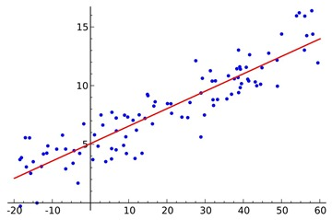
LOGISTIC REGRESSION:
Logistic regression is a supervised learning classification algorithm used to predict the probability of a target variable. The nature of target or dependent variable is dichotomous, which means there would be only two possible classes. ... Mathematically, a logistic regression model predicts P(Y=1) as a function of X.
Logistic Regression is used when the dependent variable (target) is categorical. For example,
To predict whether an email is a spam (1) or (0)
Whether the tumor is malignant (1) or not (0)

Slide 12
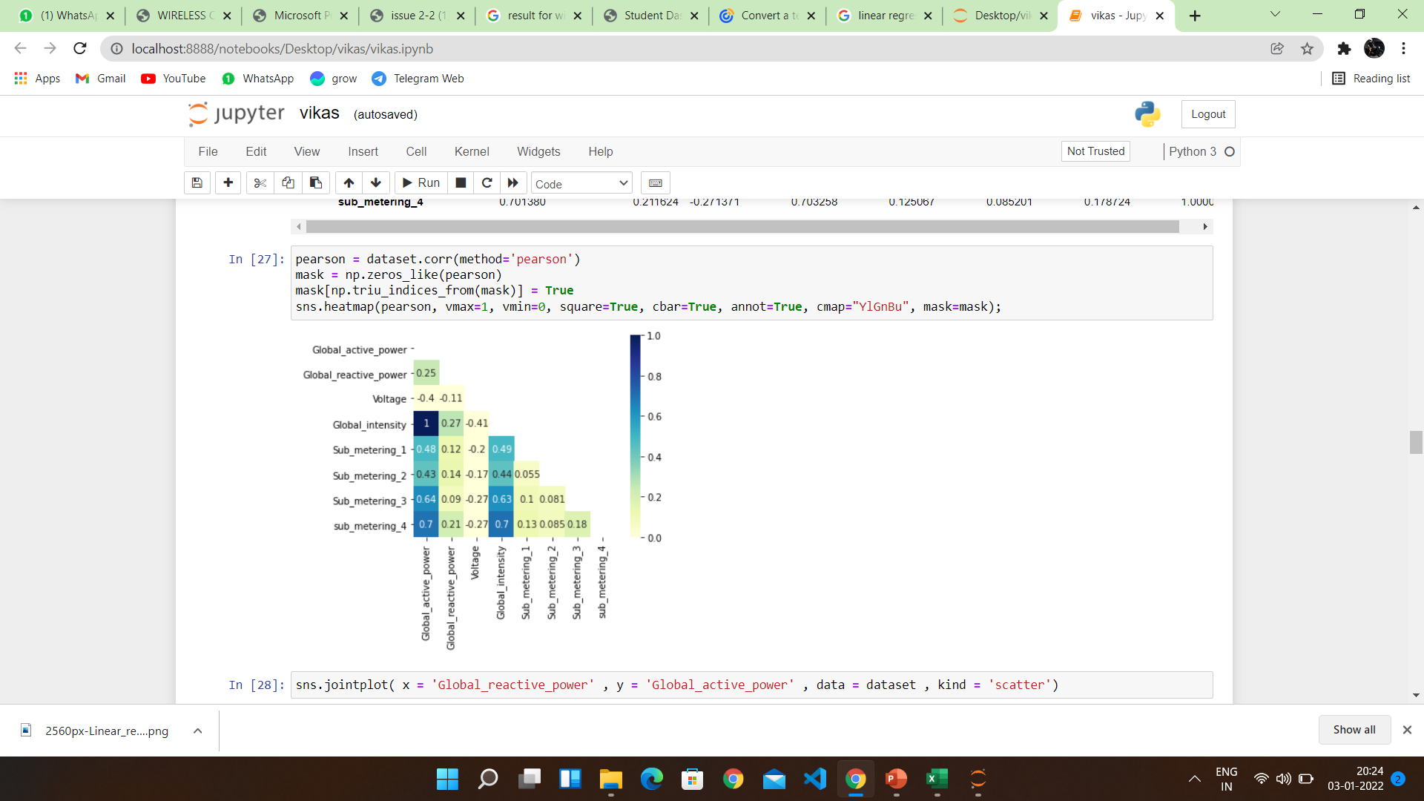
VISUALISATION OF GRAPHS
Pair plot usually gives pair wise relationships of the columns in the dataset From the above pair plot we infer Global_active_power,Global _reactive_power
Voltage ,Global_intensity Sub_metering_1,
Sub_metering_2 ,
Sub_metering_3

Slide 13
SOFTWARE REQUIREMENTS
Anaconda navigator
Jupyter notebook
Machine learning tools: pandas,
NumPy,
Matplotlib,
Scikitlearn,
Seaborn

Slide 14
CONCLUSION
In this project we have presented the Prediction of Power consumption Analysis for house holds.
We have done the Prediction using Machine Learning Techniques.
For the better results we used Decision Tree algorithm and proved with 93% accuracy.

